Slide 1
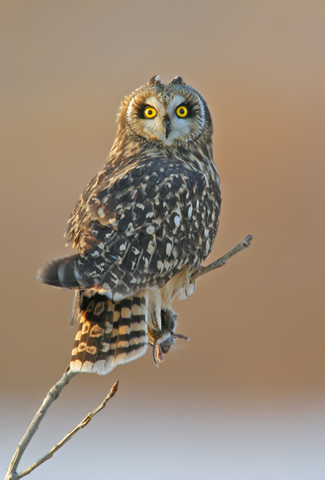
1 - Medium

Slide 2
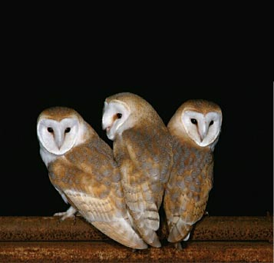
2 - Medium

Slide 3
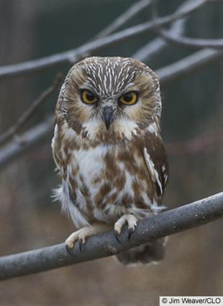
3 - Small

Slide 4
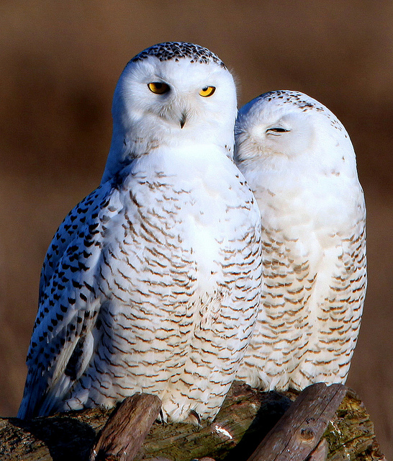
4 - Large

Slide 5
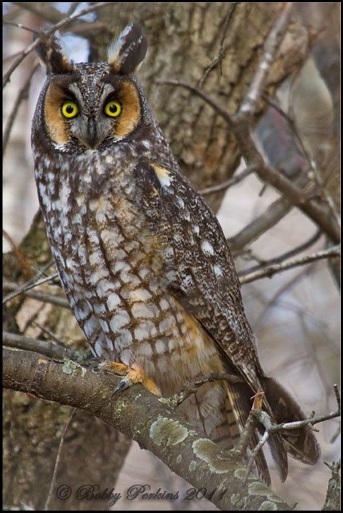
5 - Medium

Slide 6
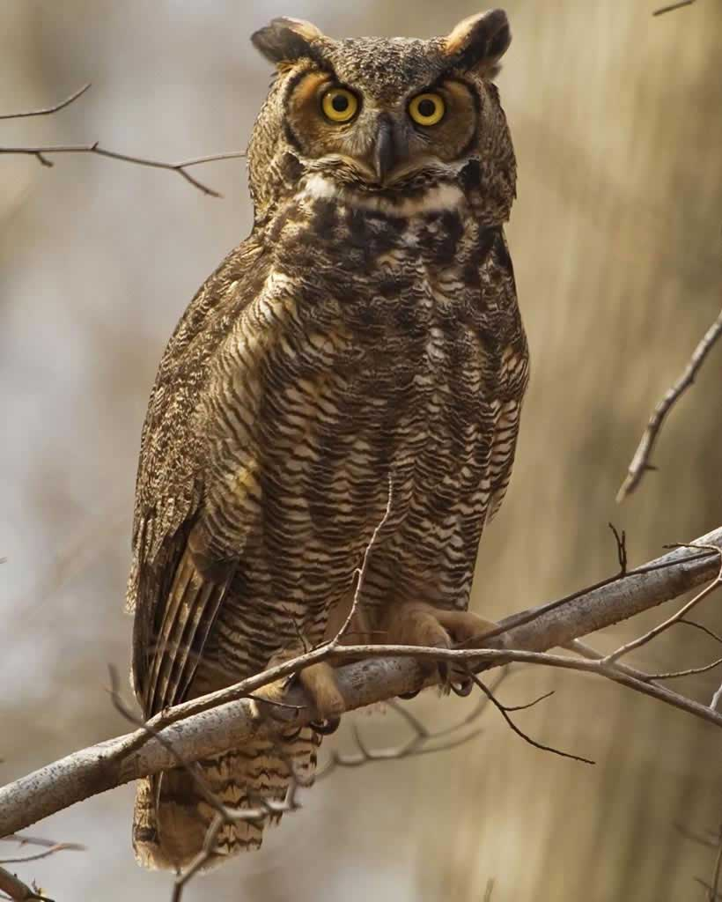
6 - Large

Slide 7
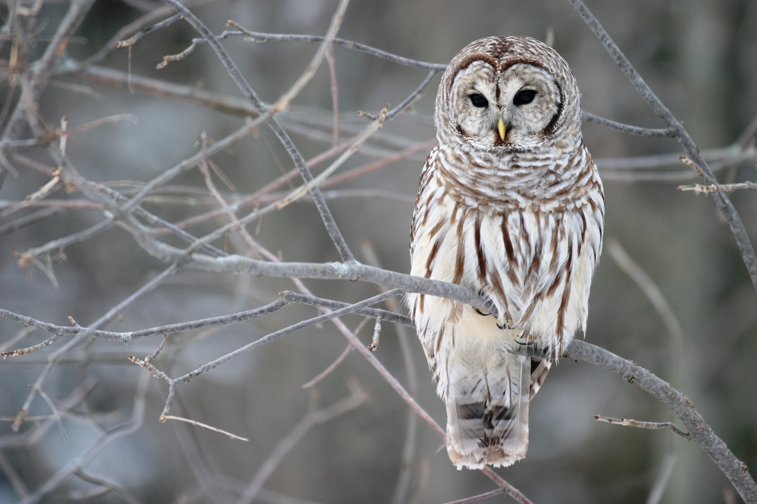
7 - Medium

Slide 8
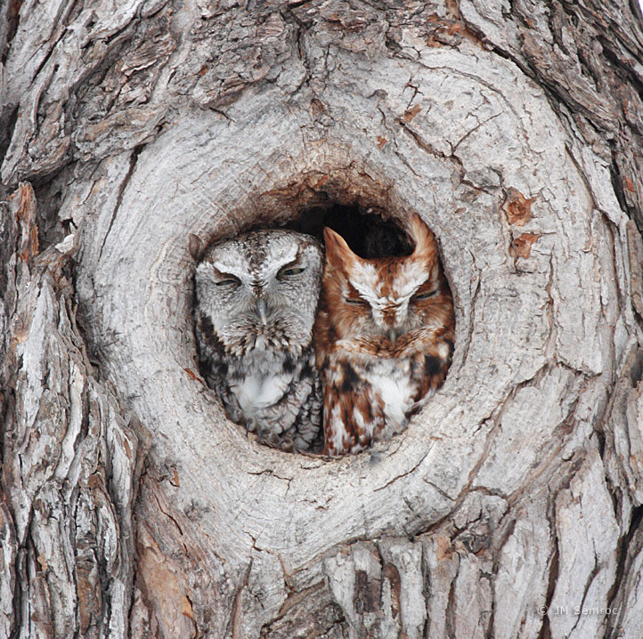
8 - Small

Slide 9
Short-eared owl
Barn owl
Saw-whet owl
Snowy owl
Long-eared owl
Great-horned owl
Barred owl
Screech owl

